Slide 1
Next Generation EU Initiative
Funding will reach €672.5 bn BEFORE 2023:
  €312.5 bn in grants
  €360 bn in loans raised from the market
  Member States to prepare National Recovery and Resilience Plans to apply for funding:
  37% must be on climate related actions (includes buildings)
  20% must be on digitalisation

Slide 2
Role of Buildings in Recovery Plans (NRRP)
Energy renovation counts as climate-related investment
Investments must be matched to reforms
Several opportunities to receive technical assistance (TA) exist
New Technical Support Instrument under the RRF
ELENA facility extended and expanded
Direct budget line in NRRP for TA possible

Slide 3
Why #Renovate2Recover?
  For every €1 million invested in energy renovation of buildings, an average of 18 jobs are created in the EU.
  Holistic, energy efficient renovation of hospitals reduces patient stay times by about 11% leading to a potential annual benefit of about €45 billion to the EU economy per year
  EcoLogic finds that France should spend > €6.4 bn on energy renovation programmes

Slide 4
Examples From NRRP’s Across the EU:
Croatia will use recovery funds for energy renvoation – earthquake resistance included
Romania will exceed the “fair share” proportion of its EU Recovery Funds for comprehensive renovation actions
Italy will use more than the “fair share” of its Recovery Funding on deep energy renovation in its super eco-bonus scheme
Spain intends to channel Recovery Funding into comprehensive renovation to alleviate energy poverty

Slide 5





The Imperative to Invest in
Renovation for Recovery
Putting Building Renovation into National Recovery and Resilience Plans
08/04/2021
Conference Organised by:
Presentation by
Adrian Joyce
Campaign Director
@adrian_joyce
adrian.joyce@euroace.org

Slide 6

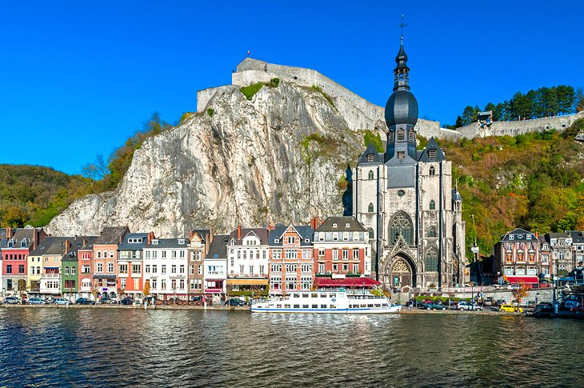
The Buildings Sector in the EU
Around 210 million buildings – about the area of Belgium
Buildings =
  50% of annual fixed capital assets
  40% of primary energy consumption
  36% of GHG emissions
Construction sector =
  Annual turnover: €1,400 billion – 9% of EU GDP
  About 16 million jobs
  About 3.5 million enterprises
  97% of enterprises have less than 10 employees
Most buildings are wasting energy: 3% have “A” label

Slide 7
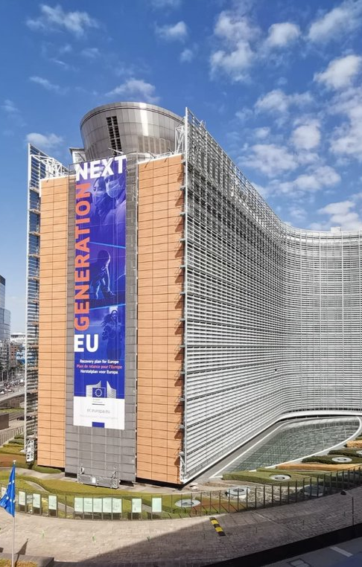
Next Generation EU Initiative
The EU Strategy for Recovery from COVID 19
Funding will reach €672.5 bn BEFORE 2023:
  37% must be on climate related actions (includes buildings)
  20% must be on digitalisation
  €312.5 bn in grants
  €360 bn in loans raised from the market
Member States to prepare National Recovery and Resilience Plans to apply for funding
Recovery funding is additional to EU budget of €1,100 bn

Slide 8
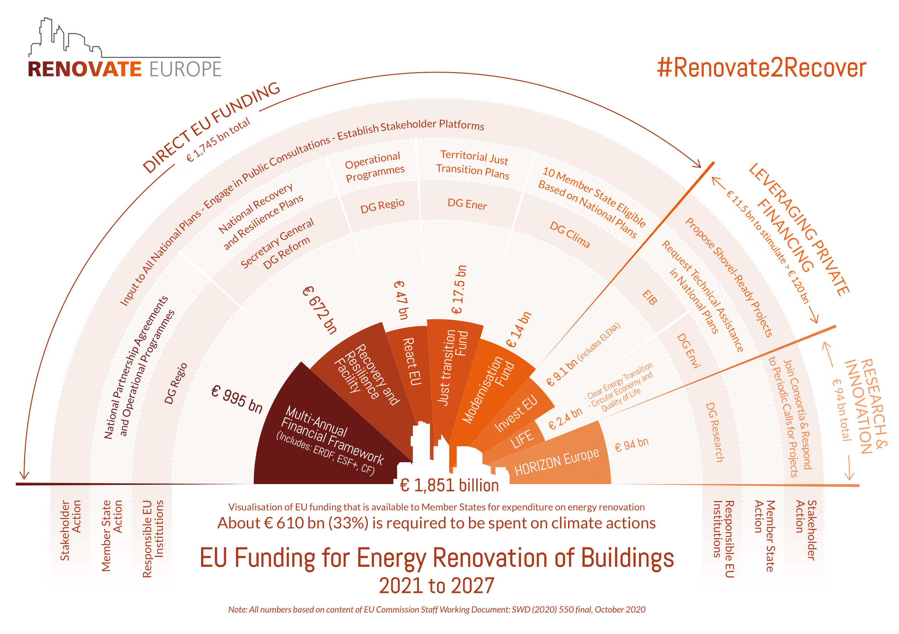
Potential EU Funding for Energy Renovation (2021-2027)
DOWNLOAD

Slide 9
Role of Buildings in the Recovery and Resilience Facility
National Recovery and Resilience Plans
Timeline for submission to European Commission: 15th of October - 30th of April
Investment priorities must match with reforms to spur absorption of funding
Minimum percentages for key policies:
  37% must be on climate-related investments
  20% must be on digitalisation
Commission SWD Guidance to Member States Recovery and Resilience Plans (22/01/2021)
“Under Flagship Renovate : By 2025, contribute to the doubling of the renovation rate and the fostering of deep renovations”
Examples of typical reforms and investments:
“Renovation wave of residential buildings, social and affordable housing, private or public buildings (focus schools, hospitals), modernisation of district heating system and land restoration”

Slide 10
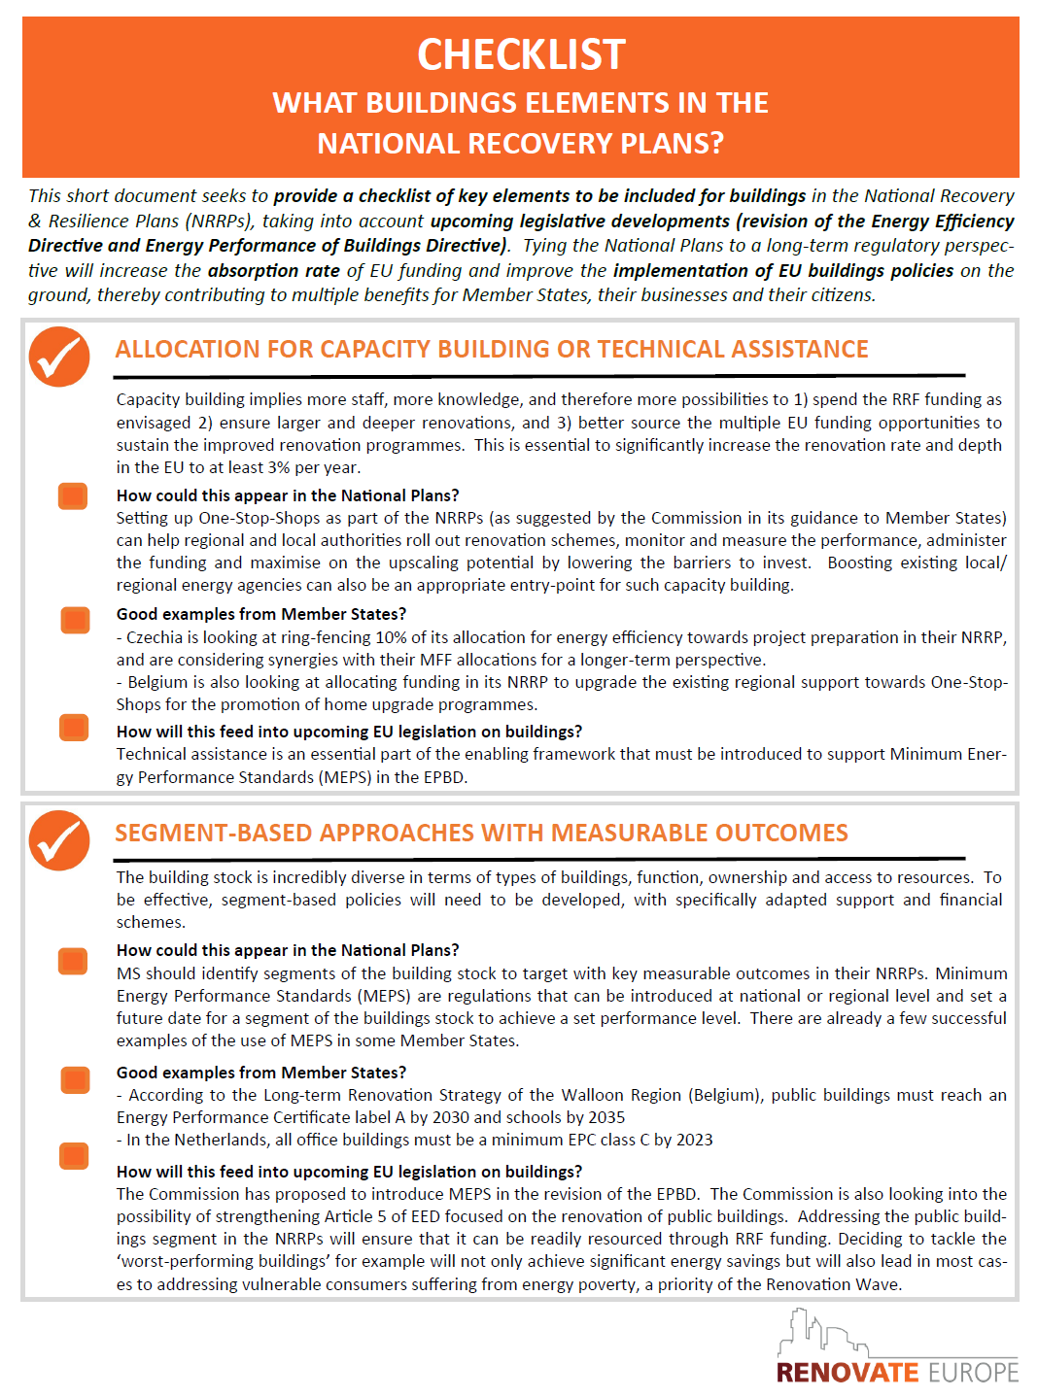
Technical Support and Capacity Building
Significantly Increased via:
DG Reform with €1bn budget. Annual deadline for requests before 30th October
New Technical Support Instrument as part of the Recovery and Resilience Facility (can be up to 4% of fund)
Possibility to have specific budget line for Technical Assistance without specific detail
ELENA technical assistance increased in MFF 2021-2027

Slide 11

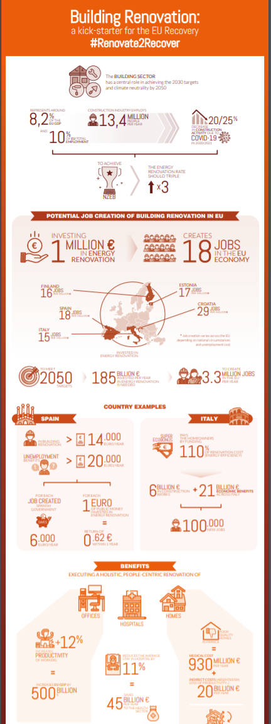
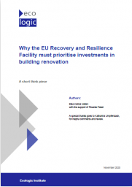
Why #Renovate2Recover?
  Energy renovation stands at the intersection of the EU’s green priorities and growth objectives and is the linchpin to the EU’s recovery:
  For every €1 million invested in energy renovation of buildings, an average of 18 jobs are created in the EU.
  Holistic, energy efficient renovation of hospitals reduces patient stay times by about 11% leading to a potential annual benefit of about €45 billion to the EU economy per year
  EcoLogic finds that Poland should spend > €4.2 bn on renovation
READ HERE
READ HERE
DOWNLOAD

Slide 12


#Renovate2Recover in action: Examples
Examples of REC National Partners inputs:
CZ: Long-term Renovation Strategy
  Contracted to prepare the national plan by the government
RO: Single-family Home Renovation Scheme
  Worked directly with Ministry to develop appropriate incentive scheme on this overlooked segment
IE: 500,000 homes by 2030 to a minimum B2 rating (-50% of GHG expected)
  Worked directly with ministry and provided evidence for ambitious action
IT: Extension of Super-Eco Bonus 110%
  Trialled approach and advised on making the tax credits tradable
#Renovate2Recover was the topic of our REDay2020
Check here

Slide 13
Comprehensive Renovation in NRRP’s
Early Indications from first NRRP’s show:
Croatia will use recovery funds – earthquake resistance included
Romania will exceed the “fair share” proportion of its EU Recovery Funds for comprehensive renovation actions
Italy will use significantly more than the “fair share” of its Recovery Funding on deep energy renovation in its super eco-bonus scheme
Spain intends to channel Recovery Funding into comprehensive renovation to alleviate energy poverty
READ HERE

Slide 14
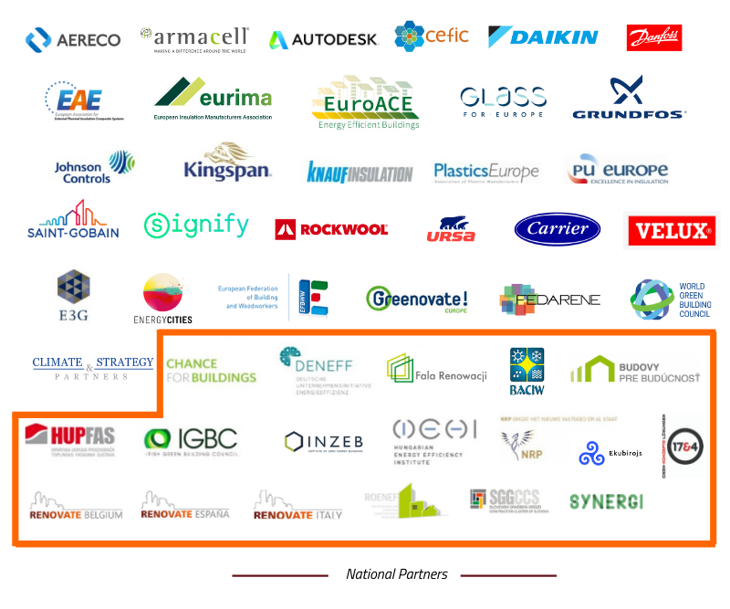

The Renovate Europe Campaign
47 Partners
Who are we?
A political communications campaign beating the drum for deep energy renovation of the building stock in the EU
Supported by 47 partners from industry and civil society including 18 national partners
Champions from politics, businesses and communities
Launched in 2011 as an initiative of EuroACE
18 National Partners

Slide 15
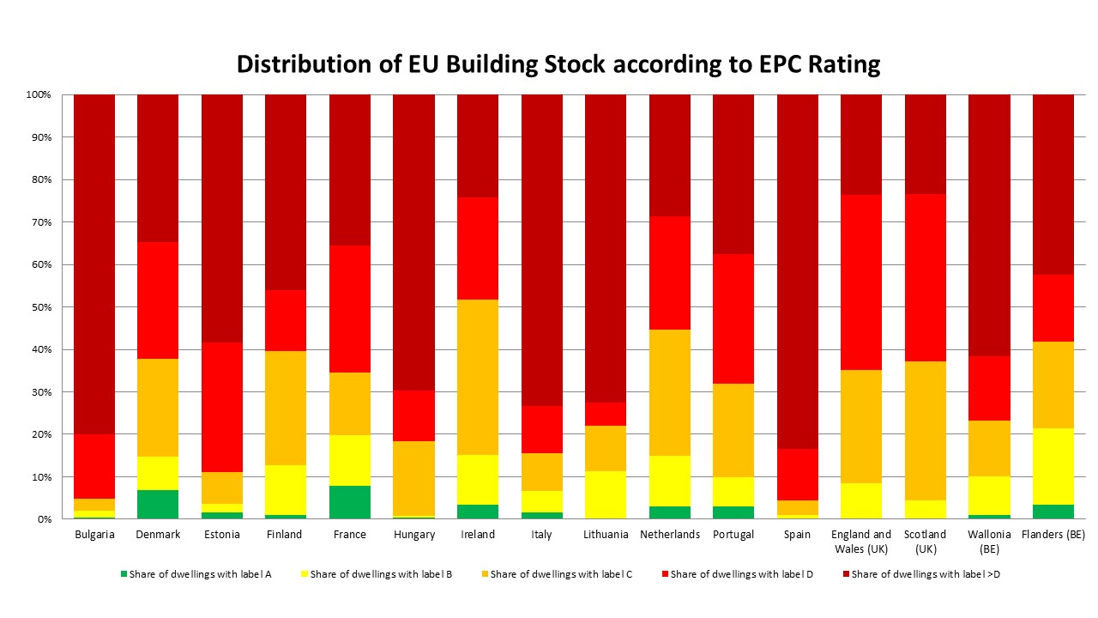
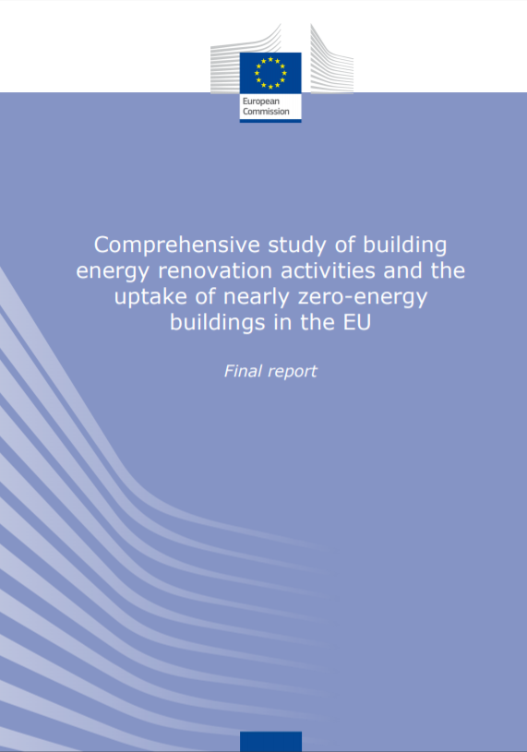
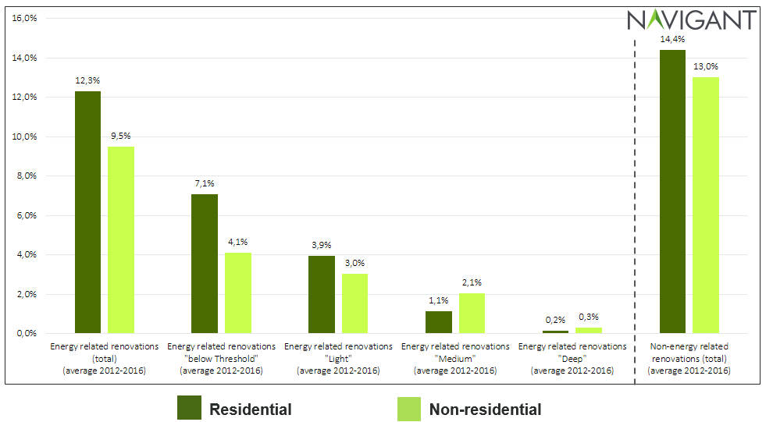

The Renovate Europe Campaign
Objectives
BPIE - 2018
Our ambition is to reduce the energy demand of the building stock in the EU by 80% by 2050
Implies that the rate of energy renovation in the EU will have to reach 3% annually and all renovations will need to be deep renovations
We target policy & decision-makers at the European and national levels
Energy renovation: 0,2% deep renovation
European
Commission
2019

Slide 16
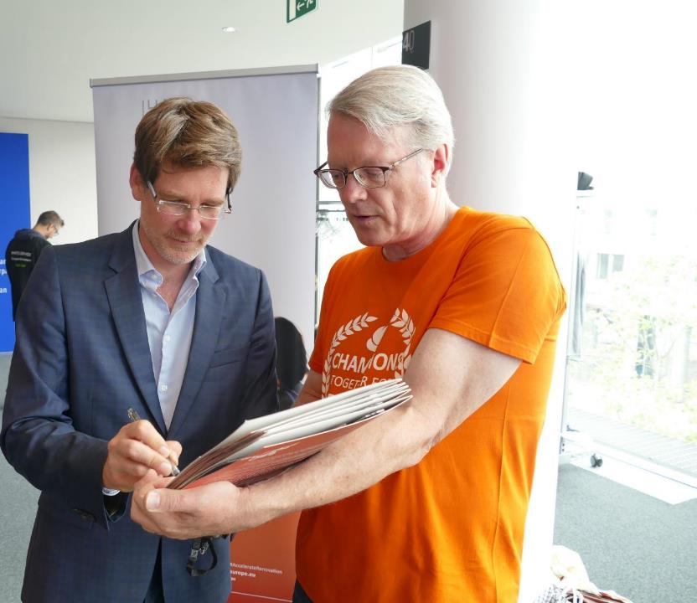
Champions for Renovation
34 Current MEPs
8 Former MEPs
3 Cities
1 National MP
#PrioritisePeople
#AccelerateRenovation
#Renovate2Recover
46 Champions

Slide 17


Thank you!
https://www.renovate-europe.eu
@RenovateEurope
info@renovate-europe.eu

