Slide 1
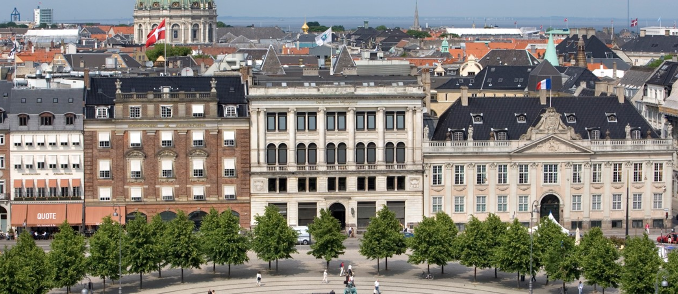
Investing in deep renovation for recovery :
a how-to guide for Member States
Panel 1 Macroeconomic benefits and guiding principles
April 8, 2021
10 a.m. – 12 p.m.
Stephane QUEFELEC
Expert – Energy and Environment
April 2021

Slide 2
The European Environment Agency
An independent EU agency
Collects, analyses, assesses and provides information on environmental and sustainability issues
Knowledge institution
Interfaces between science and policy
Depends upon strong networks to carry out its work - EIONET
EEA members and cooperating countries

Slide 3


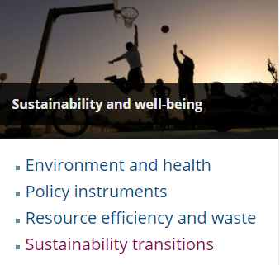







Informing policy implementation
Informing policy implementation
Air pollution, transport and noise
Industrial
pollution
Climate change mitigation and energy
- Sustainability transitions
- Global megatrends and planetary boundaries
State of the Environment reporting in Europe
Just transition
Sustainability and well being
- Building
Climate change impacts, vulnerability and adaptation
Water management, resources and ecosystems
Marine and maritime, fisheries and coastal
Waste and material resources
Biodiversity, ecosystems, agriculture and forests
Urban, land use and soil

Slide 4
From quantitative macro benefits…
Construction sector in Europe: 9% of the GDP, around 18 Million Jobs, local economy (mainly SME)
Buildings: 40% of the EU’s total energy consumption, and for 36% of its greenhouse gas emissions from energy
Energy use in buildings, fuel mix and dependency from foreign supply
EGD EC impact assessment: regarding EE, “most savings would need to come from buildings”
Stimulus in the construction ecosystem and the broader economy (Recovery plan)
Job market impact - A Renovation Wave for Europe - greening our buildings, creating jobs, improving lives
  By 2030 an additional 160 000 green jobs could be created in the EU construction sector through a renovation wave
  Past experience: Ireland

Slide 5
…to the distribution of economic benefits
European Green Deal – Leaving no one behind - The renovation wave initiative and the Just transition
Distributive impacts of climate change policies: what about policy supports for EE in residential buildings ?
On going work at the EEA level (to be published in the coming weeks)
Strong potential for progressive policies

Slide 6
… and of non-monetary effect
Energy-efficient improvements allow to save on energy bills in the medium-long term
They have the potential to have progressive income effects since lower income groups spend a more important share of their budget on energy bill than higher level income groups.
Non-monetary benefits:
  Increased health: reduced mortality, improved respiratory and cardiovascular conditions, reduced symptoms of arthritis, rheumatism and allergies
  Improved living comfort
Benefit specific to lowest income households and specific social groups

Slide 7
Under certain conditions
Two factors to be included for EE in building policies to deliver their progressive potential:
  Intensity of support adjusted by income level
  Accessibility/Easy access to support
Deep renovations - Alleviation of energy poverty – energy dependency of households - household exposure to energy costs
Beware of :
  context/schema which may exclude lower income groups (e.g.: Tenant)
  Rebound effect and income level
  Excessive insulation/health aspects

Slide 8
Increasing evidence suggests wider socio-economic benefits (health, well being, …) of energy efficiency investment
Policies to support people in investing Energy efficiency policies have the potential to:
  have progressive income effects
  reduce inequalities in environmental risk exposure
Quantifiying the non-monetary benefits of EE efficiency action in building
Addressing energy poverty is essential

